Slide 1
Slaviša Đurđić
Star Wars
Goal: Analysis of the Tableau “Star Wars Character Details” lifestyle sample dataset.
Instructions:
- Collect data by downloading the json file from https://public.tableau.com/app/learn/sample-data?qt-overview_resources=1#qt-overview_resources.
- Load the JSON data to MySQL table(s).
- Execute some basic SQL queries.
- Build visuals in Tableau (https://public.tableau.com/app/profile/slavisadurdic/viz/StarWars_16943302674260/StarWars).
- Run regression analysis in Python as well as regression and cluster analysis in Tableau.
Belgrade, September 2023

Slide 2
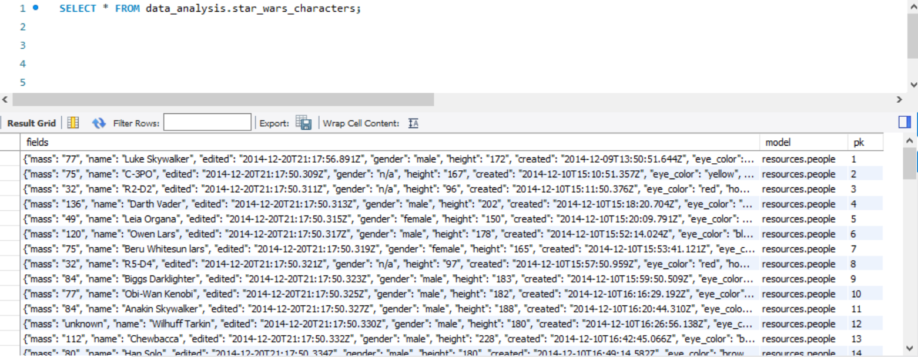
MySQL queries

Slide 3
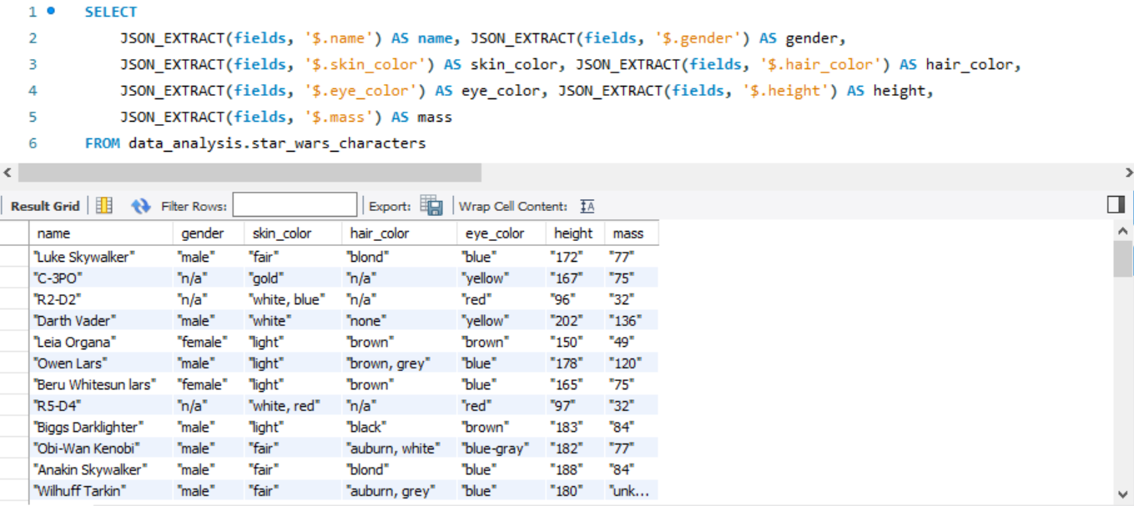
MySQL queries

Slide 4
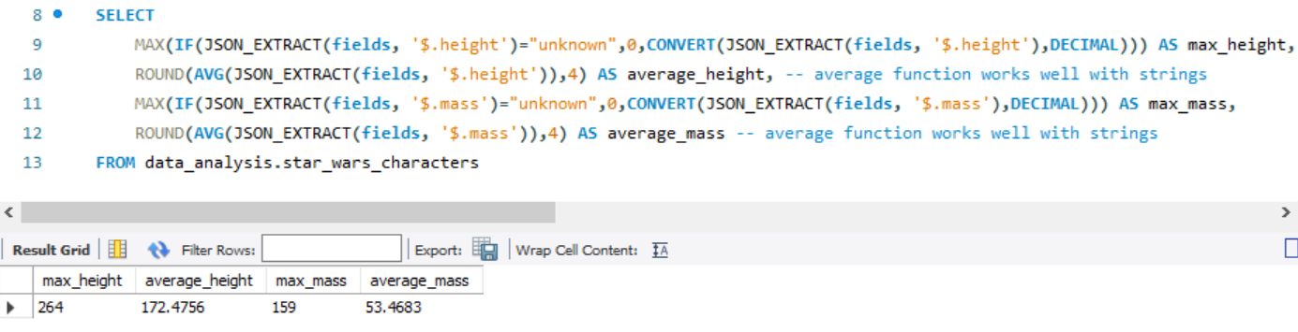
MySQL queries
Taking MAX and AVG for “height” and “mass” actor attributes.

Slide 5
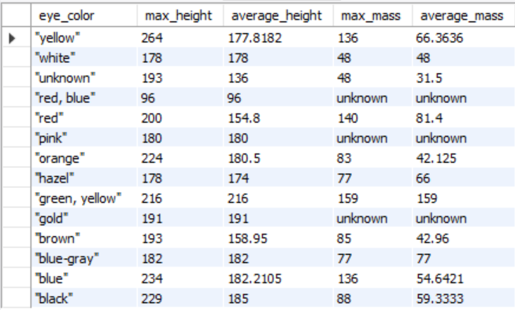
MySQL queries
SELECT
JSON_EXTRACT(fields, '$.eye_color') AS eye_color,
MAX(IF(JSON_EXTRACT(fields, '$.height')="unknown",0,CONVERT(JSON_EXTRACT(fields, '$.height'),DECIMAL))) AS max_height, ROUND(AVG(JSON_EXTRACT(fields, '$.height')),4) AS average_height, -- average function works well with strings
IF(
MAX(IF(JSON_EXTRACT(fields, '$.mass')="unknown",0,CONVERT(JSON_EXTRACT(fields, '$.mass'),DECIMAL)))=0,
"unknown", MAX(IF(JSON_EXTRACT(fields, '$.mass')="unknown",0,CONVERT(JSON_EXTRACT(fields, '$.mass'),DECIMAL)))
) AS max_mass,
IF(ROUND(AVG(JSON_EXTRACT(fields, '$.mass')),4)=0,"unknown",ROUND(AVG(JSON_EXTRACT(fields, '$.mass')),4)) AS average_mass
FROM data_analysis.star_wars_characters
GROUP BY eye_color
ORDER BY 1 DESC;

Slide 6

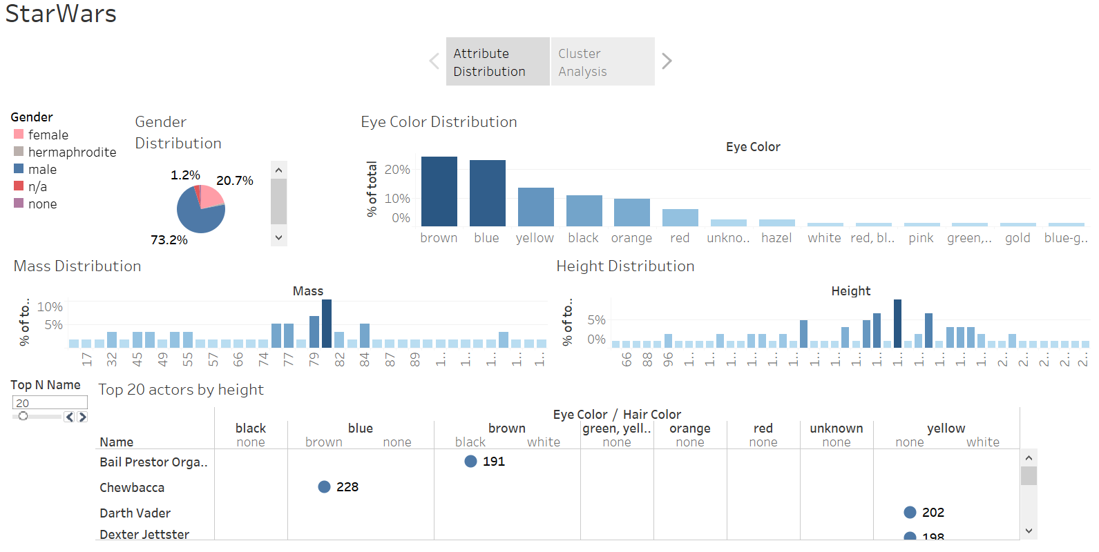

Slide 7
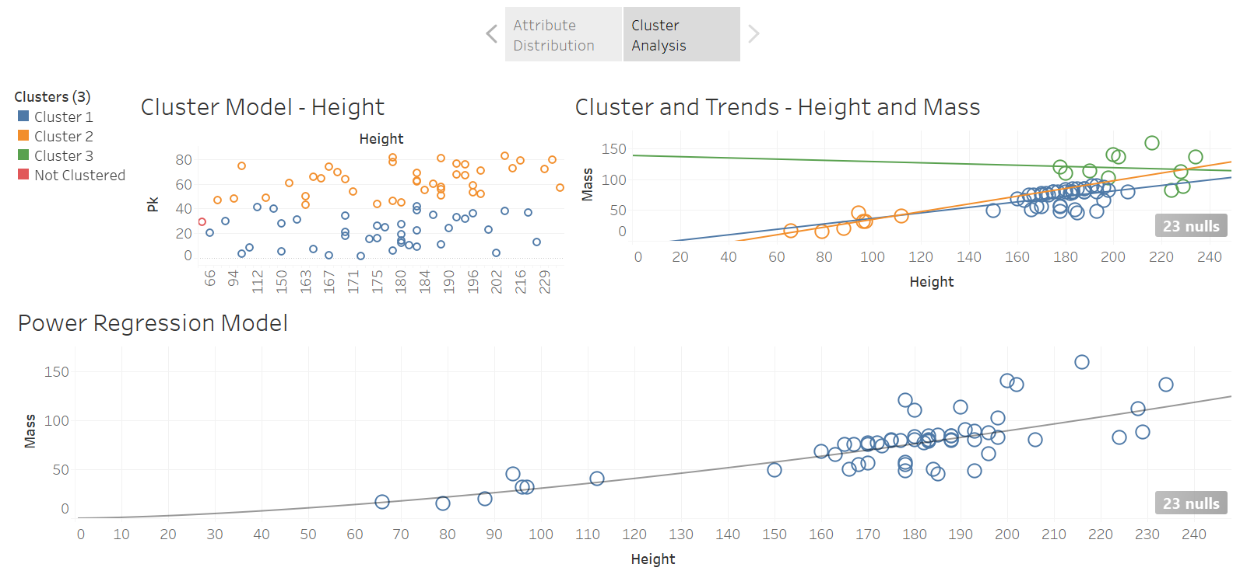

Slide 8
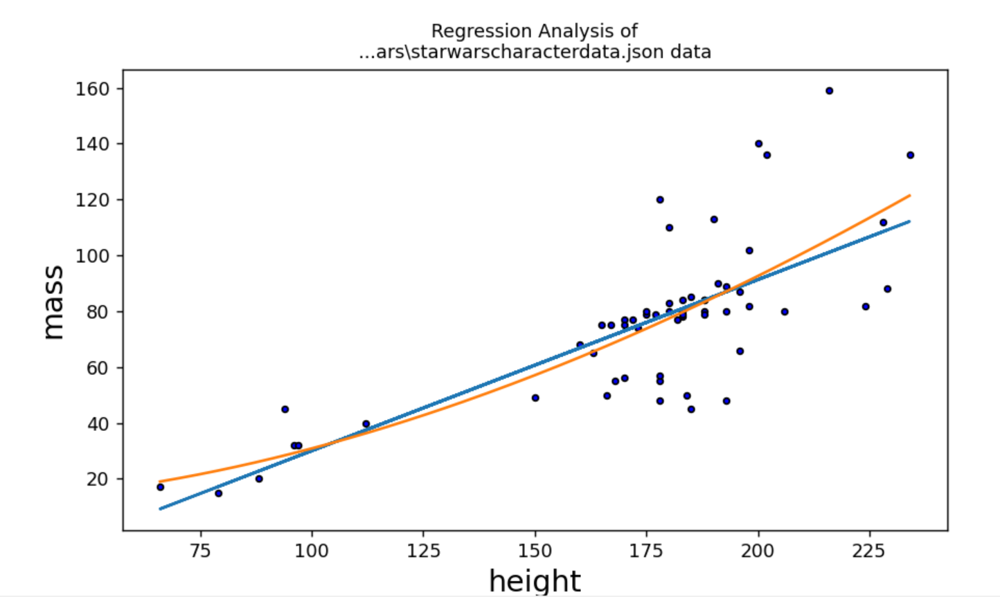
Regression Analysis in Python
Linear R is 0.75 and R^2 is 0.56
Polynomial R^2 is 0.576

Slide 9
Star Wars Project Insights
1) More than 73% of all Star Wars actors are men.
2) Mass and Height follow normal distribution.
3) Regression model is best described with power function (positive correlation, coefficient of determination is ~74%).

